Slide 1
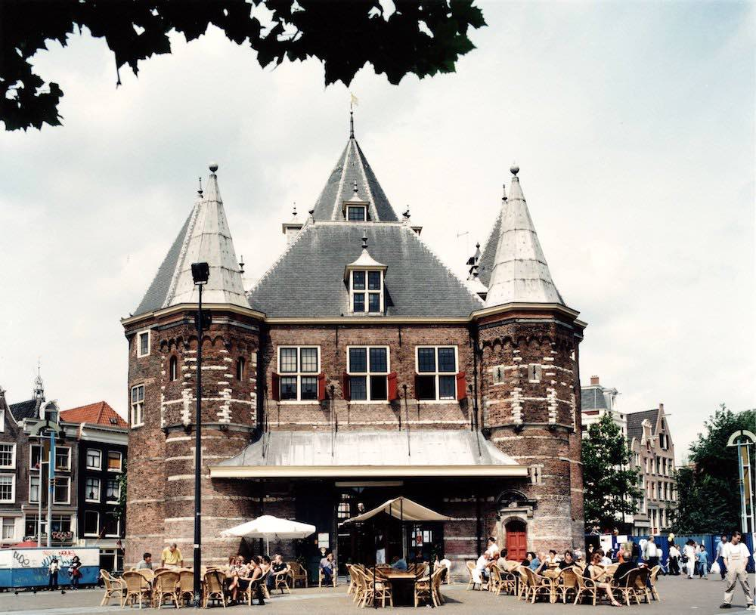


Internship
Laura Weller
AMFI 2023-2024

Slide 2
The company
General process
Intertwined activities
Future
Internship
Laura Weller
AMFI 2023-2024

Slide 3
The company
De Waag
Futurelab for technology and society
Interdisciplinary team of designers, artists and scientists, utilising public research methods in the realms of technology and society.
Open, honest and inclusive future.
Internship
Laura Weller
AMFI 2023-2024

Slide 4
The company
fablab
Fablab is a workplace that offers access to a number of computer-controlled prototyping machines, where users can convert their ideas into tangible products.
Interns can do their own projects
Internship
Laura Weller
AMFI 2023-2024

Slide 5
The company
Project
A phygital open-source biodegradable collection that can be worn during and supports an Extinction Rebellion blockade
Internship
Laura Weller
AMFI 2023-2024

Slide 6
General process
acclimatization phase
Research phase
Experimentation phase
Decision making phase
Understanding the company culture
Getting to know my colleagues
Understanding the machines
Understanding the way of working
Researching biomaterials
Researching Extinction Rebellion
Researching activism
Experimented with the biomaterials
Sizing,water resistance and compostable and strongness testing
Coloration of the materials
Sizing up to bigger scale
Internship
Laura Weller
AMFI 2023-2024

Slide 7
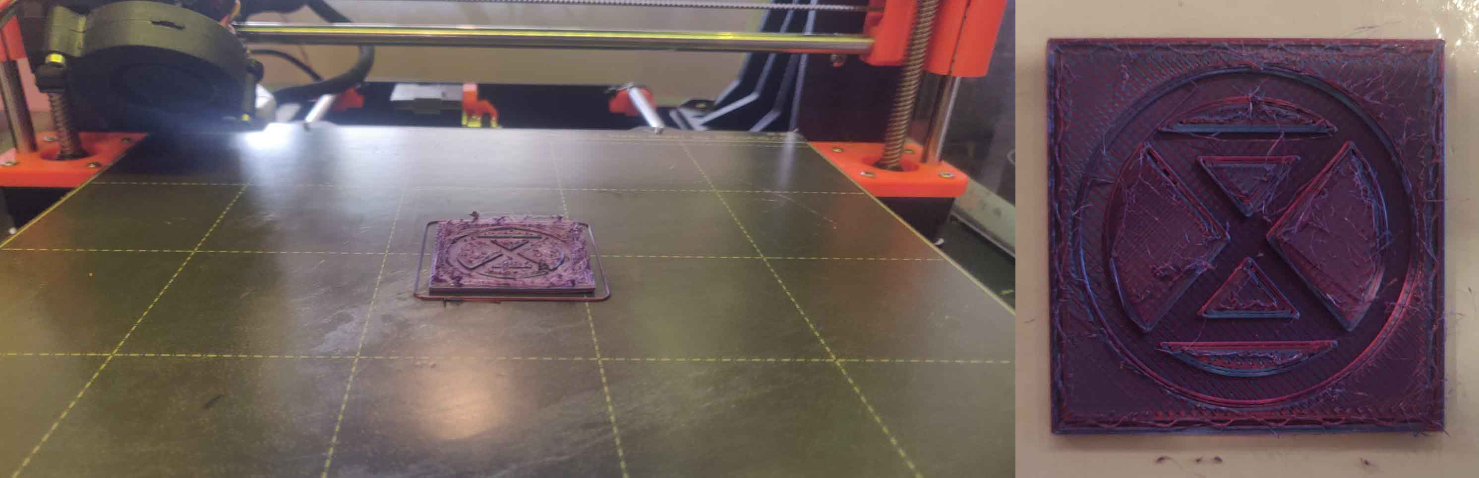
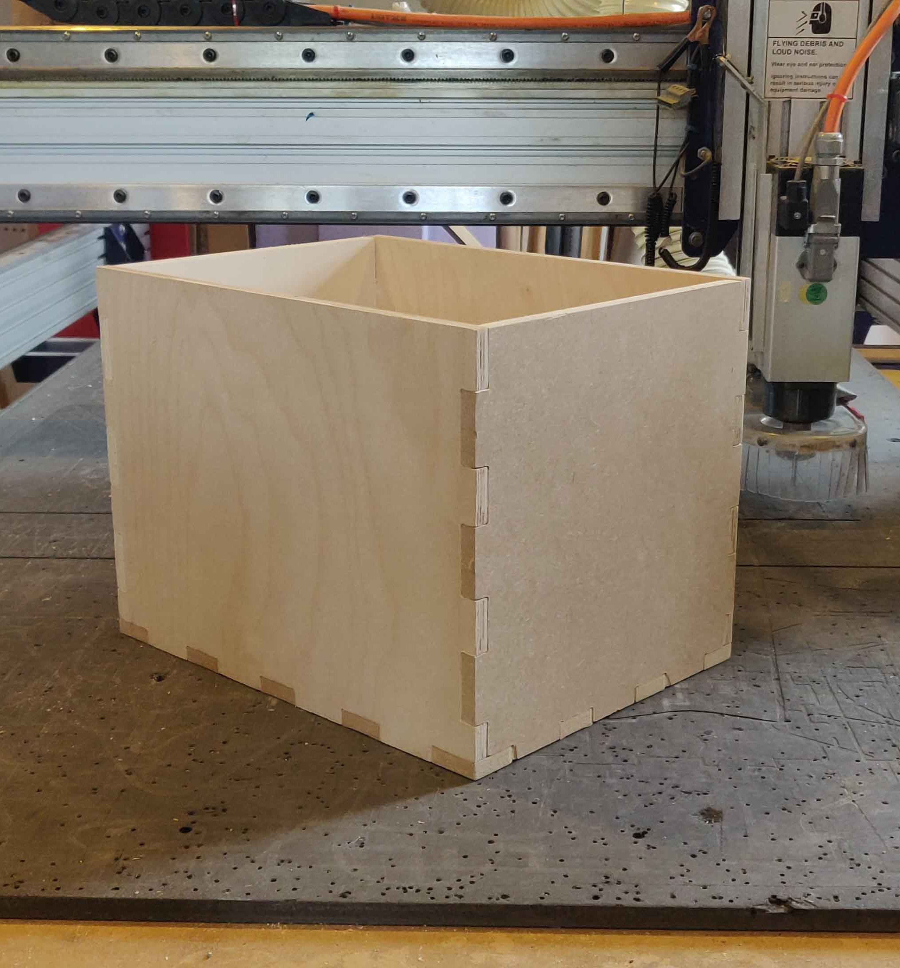
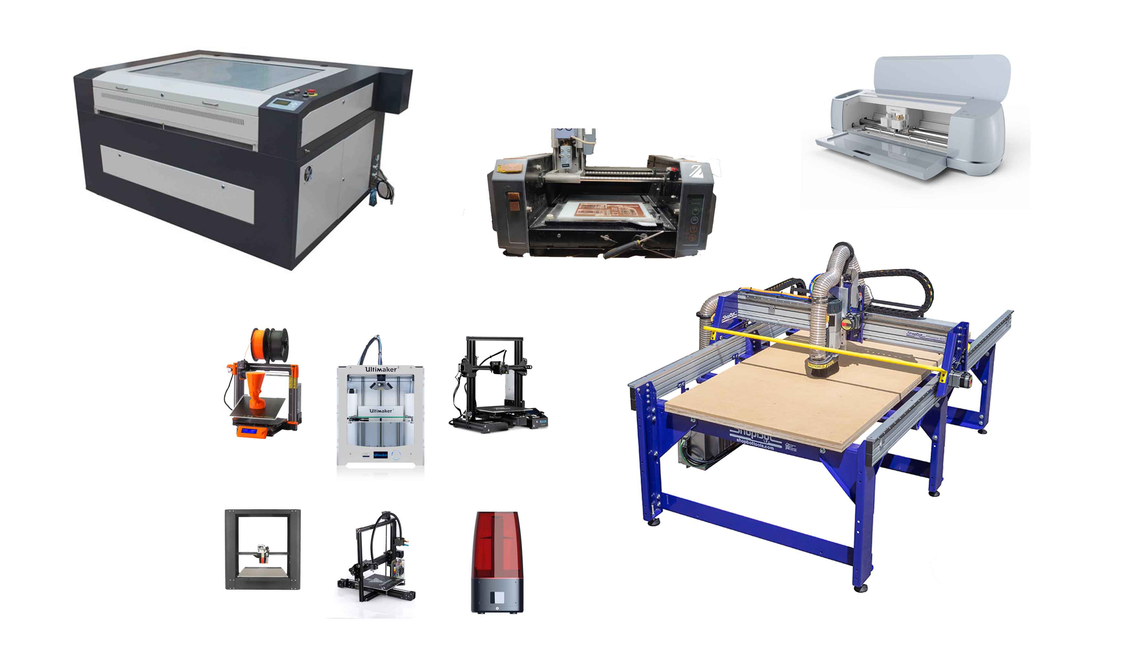
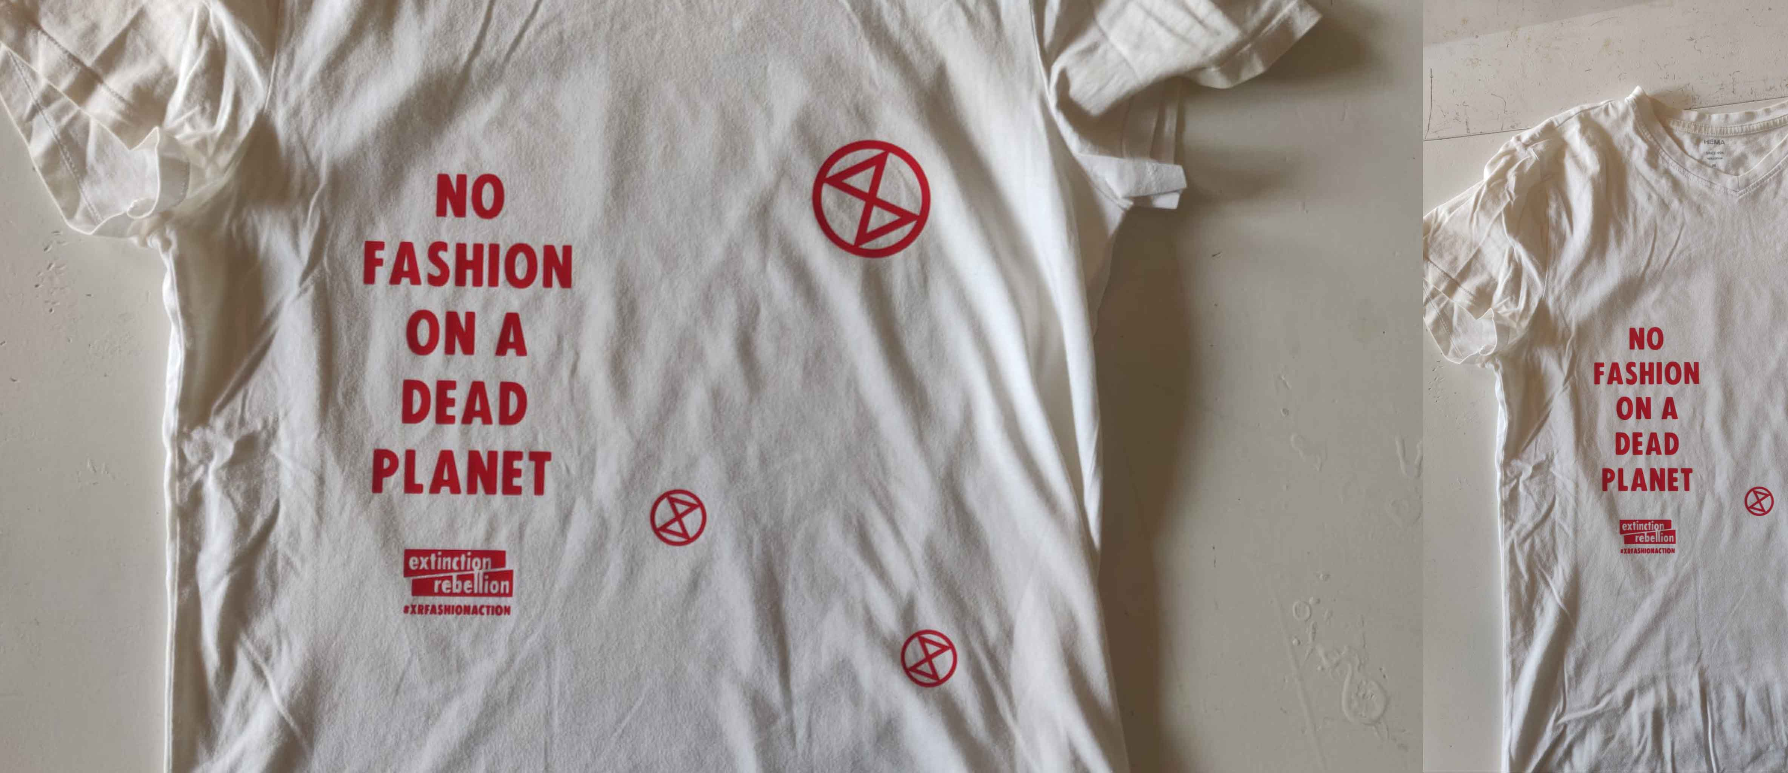
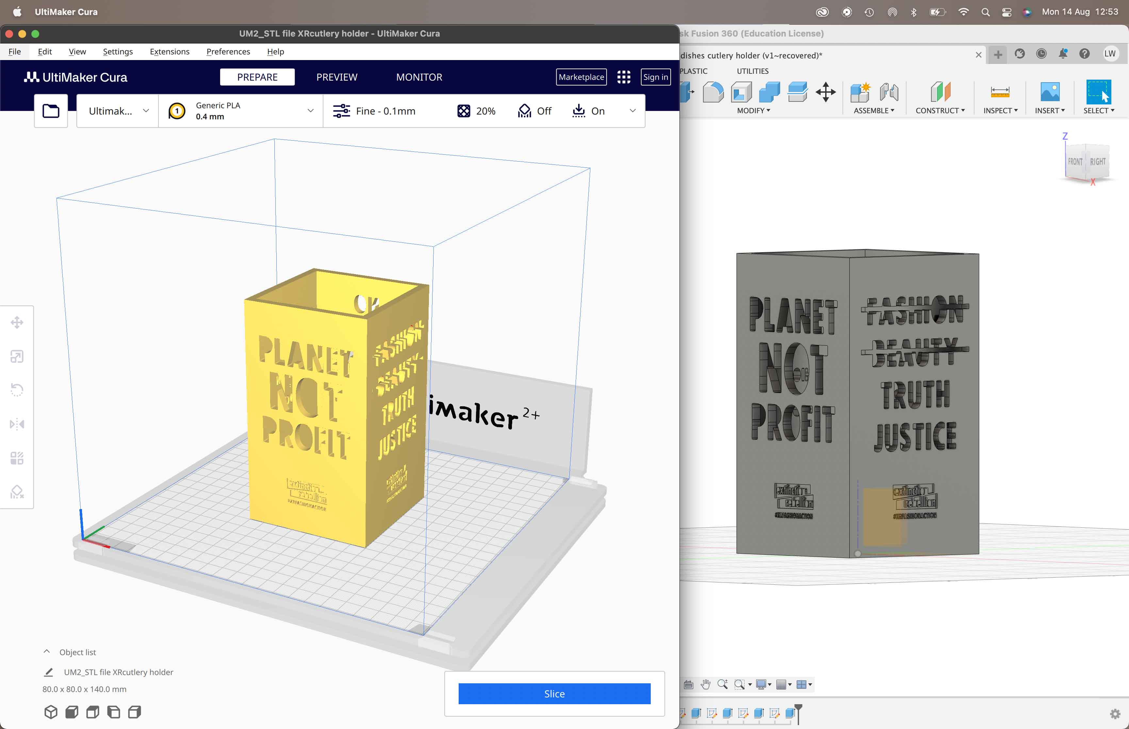
Internship
Laura Weller
AMFI 2023-2024

Slide 8
General process
acclimatization phase
Research phase
Experimentation phase
Decision making phase
Understanding the company culture
Getting to know my colleagues
Understanding the machines
Understanding the way of working
Researching biomaterials
Researching Extinction Rebellion
Researching activism
Experimented with the biomaterials
Sizing,water resistance and compostable and strongness testing
Coloration of the materials
Sizing up to bigger scale
Internship
Laura Weller
AMFI 2023-2024

Slide 9
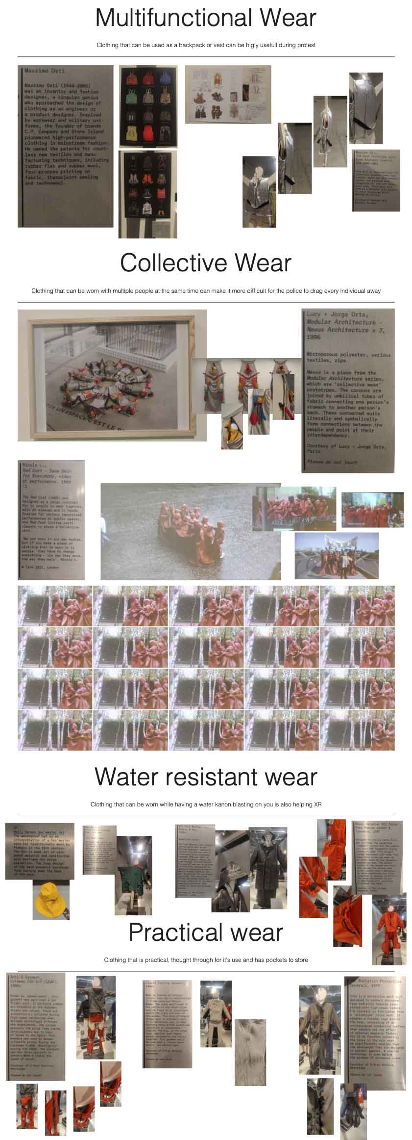
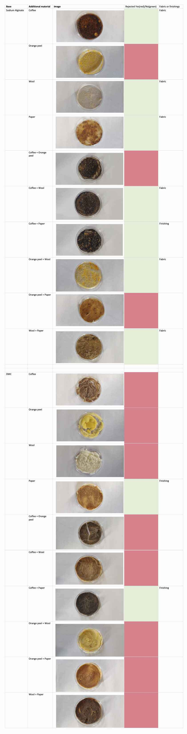

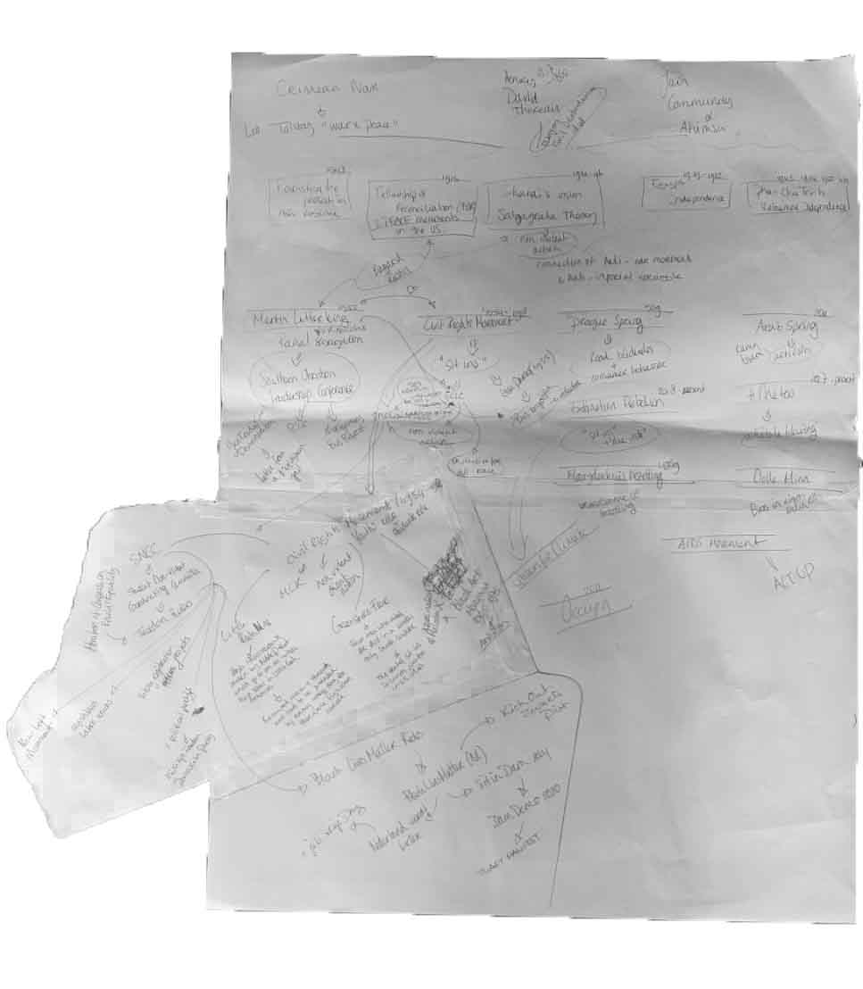
Internship
Laura Weller
AMFI 2023-2024

Slide 10
General process
acclimatization phase
Research phase
Experimentation phase
Decision making phase
Understanding the company culture
Getting to know my colleagues
Understanding the machines
Understanding the way of working
Researching biomaterials
Researching Extinction Rebellion
Researching activism
Experimented with the biomaterials
Sizing,water resistance and compostable and strongness testing
Coloration of the materials
Sizing up to bigger scale
Internship
Laura Weller
AMFI 2023-2024

Slide 11
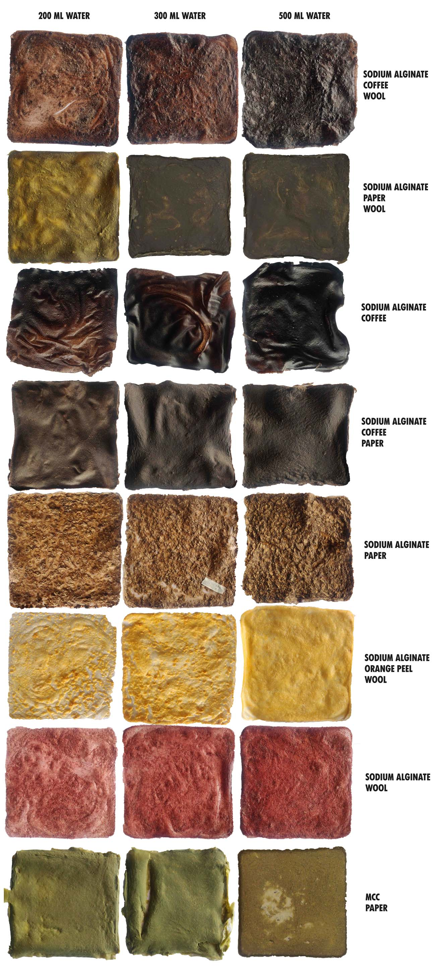
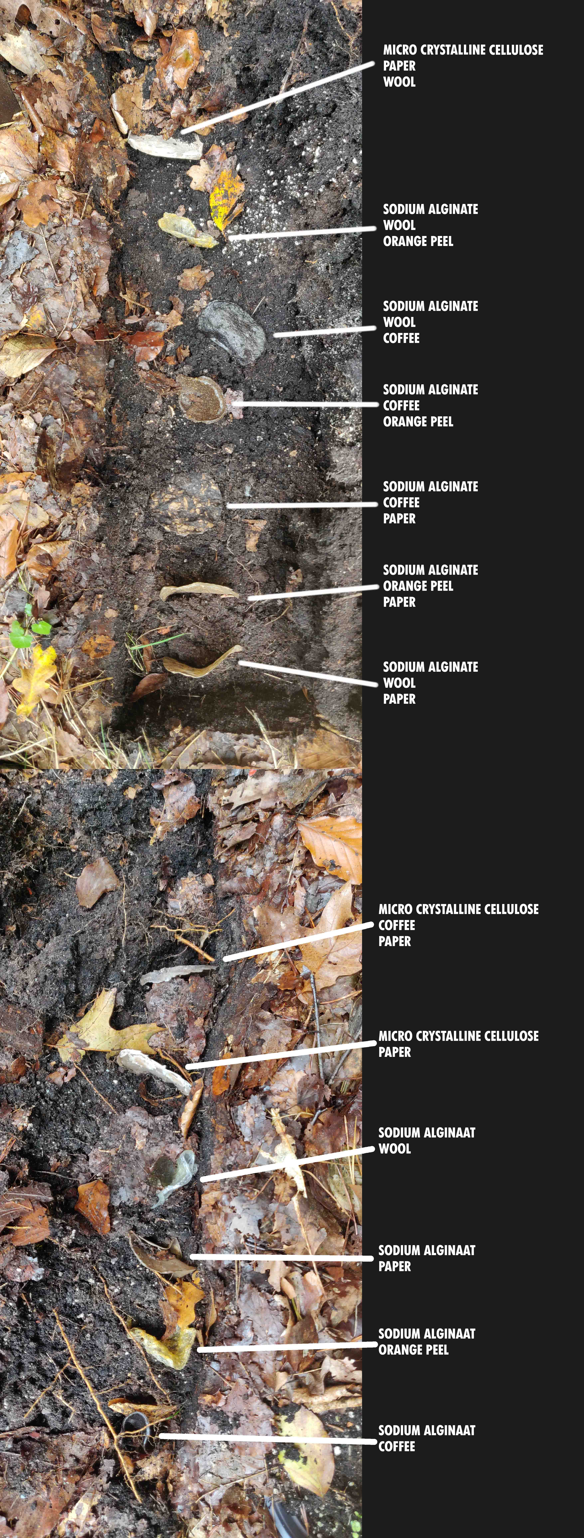
Internship
Laura Weller
AMFI 2023-2024

Slide 12
General process
acclimatization phase
Research phase
Experimentation phase
Decision making phase
Understanding the company culture
Getting to know my colleagues
Understanding the machines
Understanding the way of working
Researching biomaterials
Researching Extinction Rebellion
Researching activism
Experimented with the biomaterials
Sizing,water resistance and compostable and strongness testing
Coloration of the materials
Sizing up to bigger scale
Internship
Laura Weller
AMFI 2023-2024

Slide 13
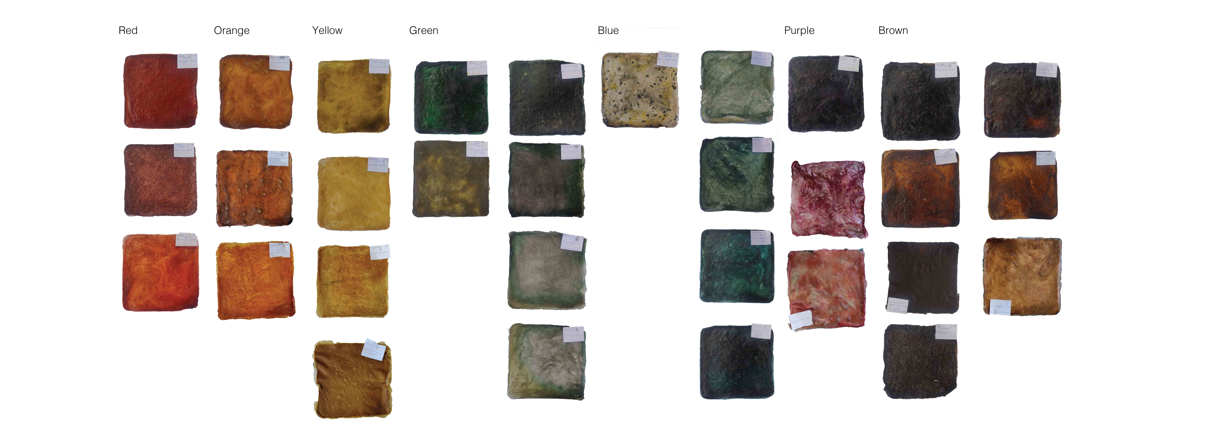
Internship
Laura Weller
AMFI 2023-2024

Slide 14
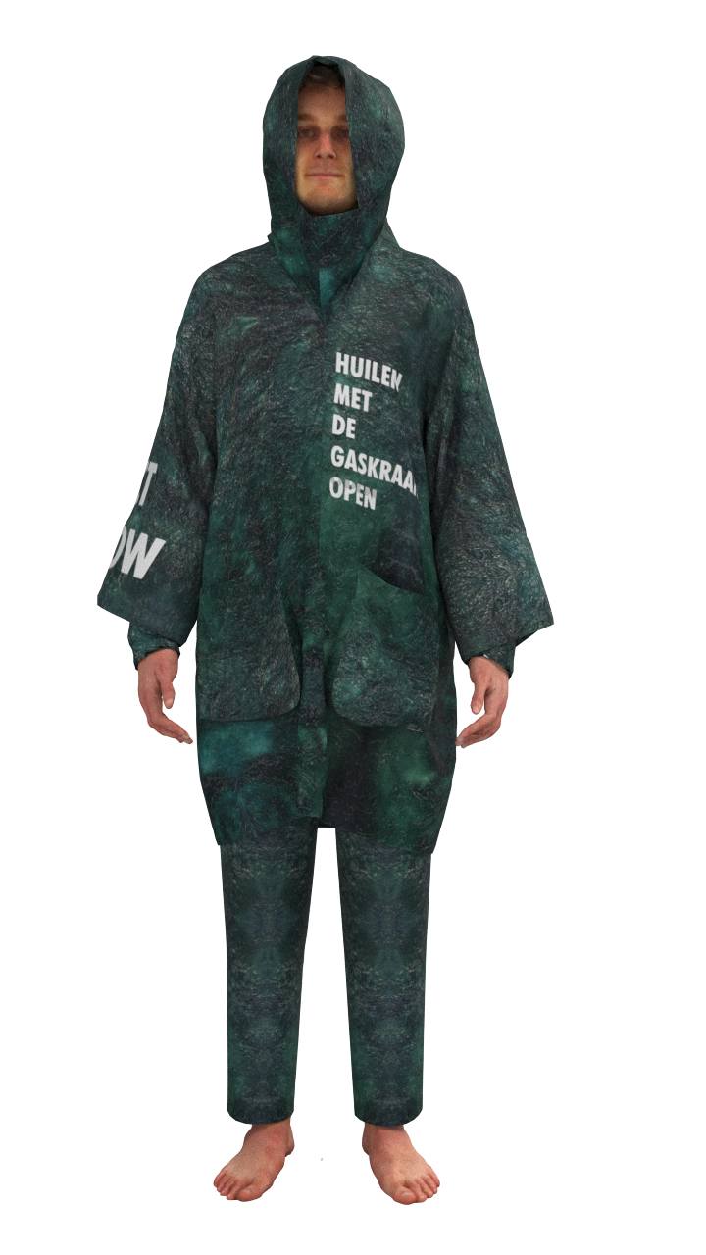

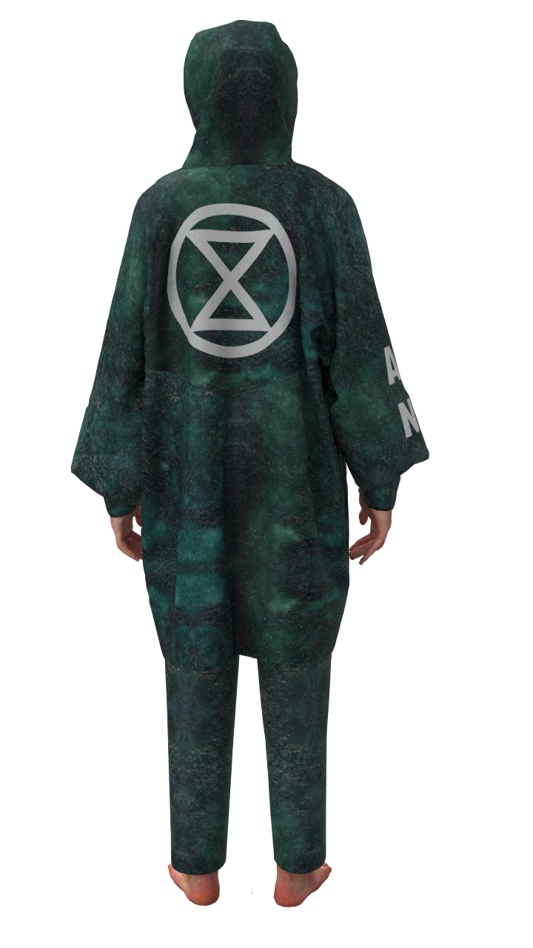
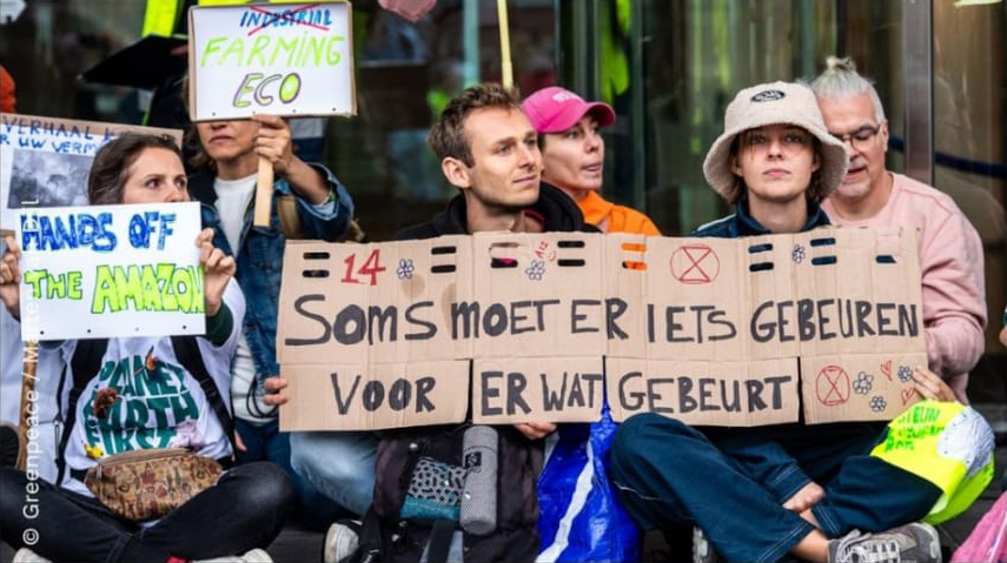
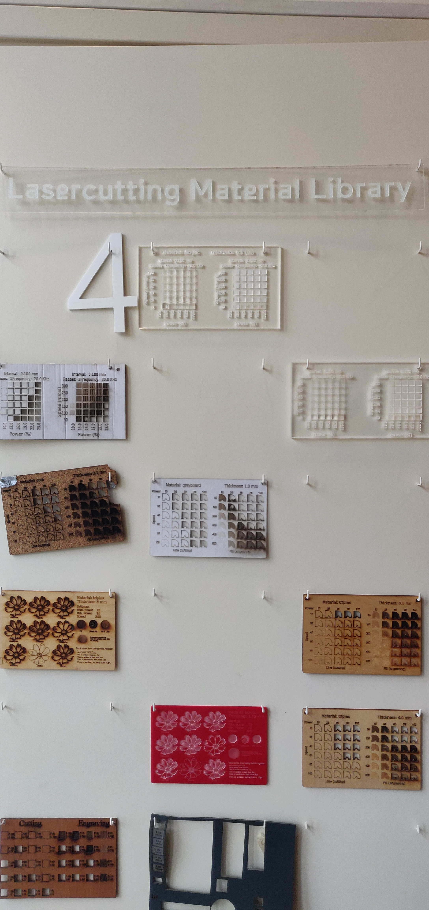
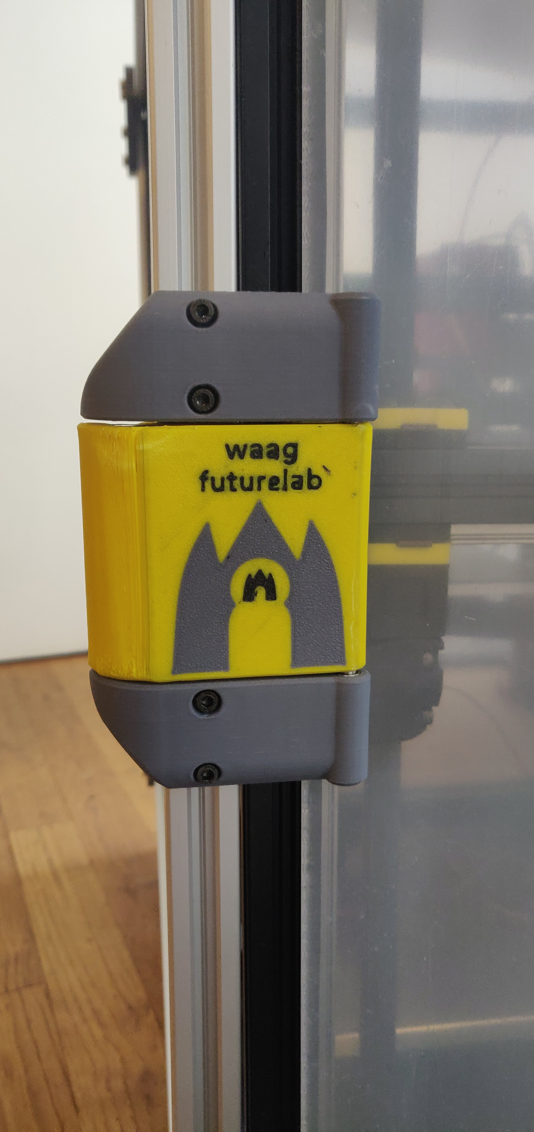
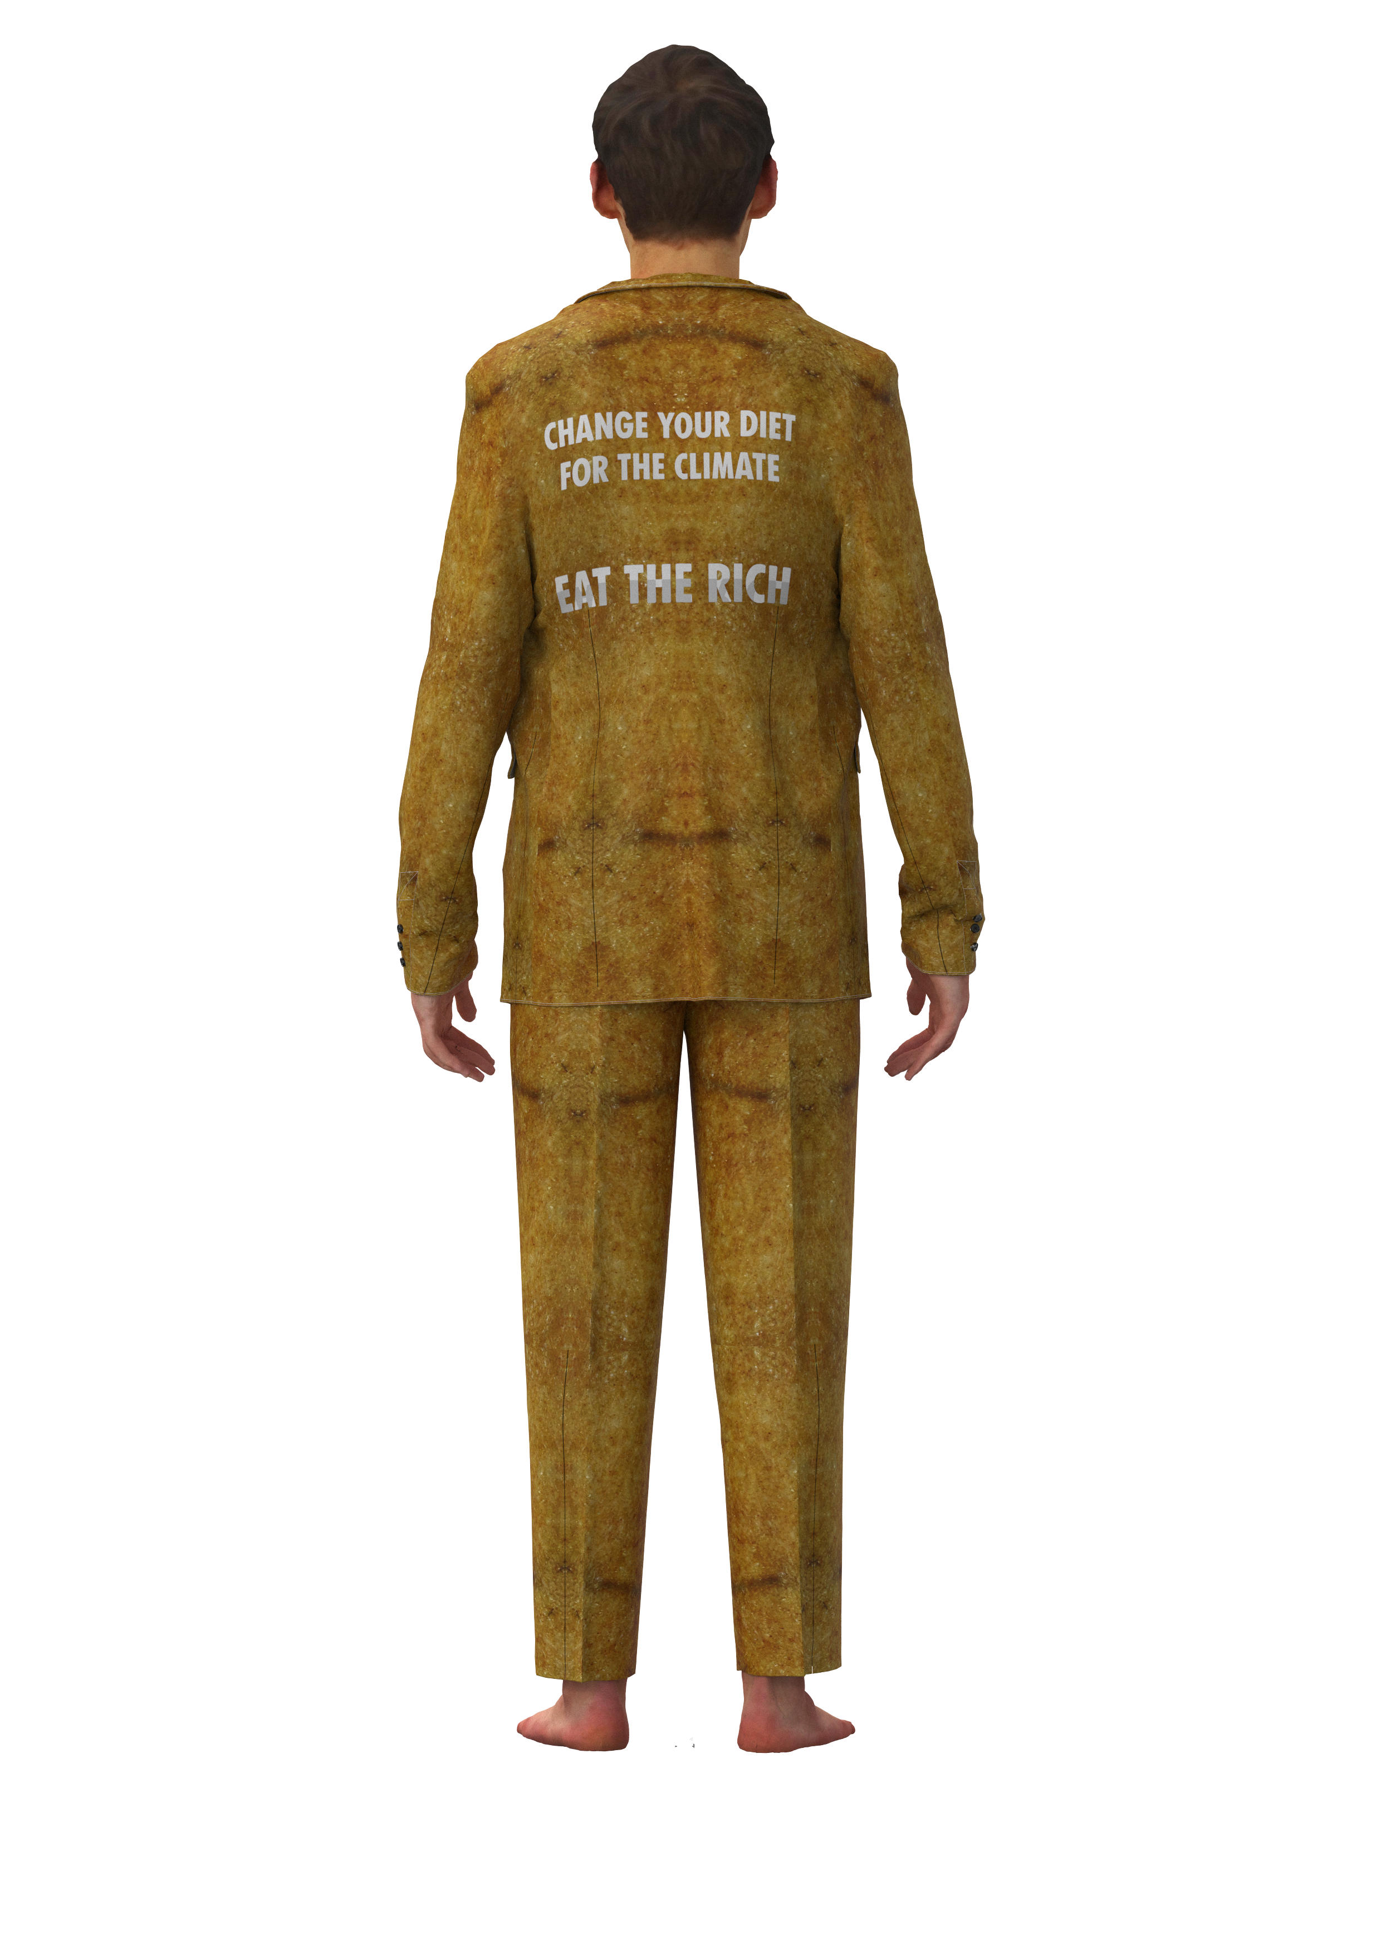
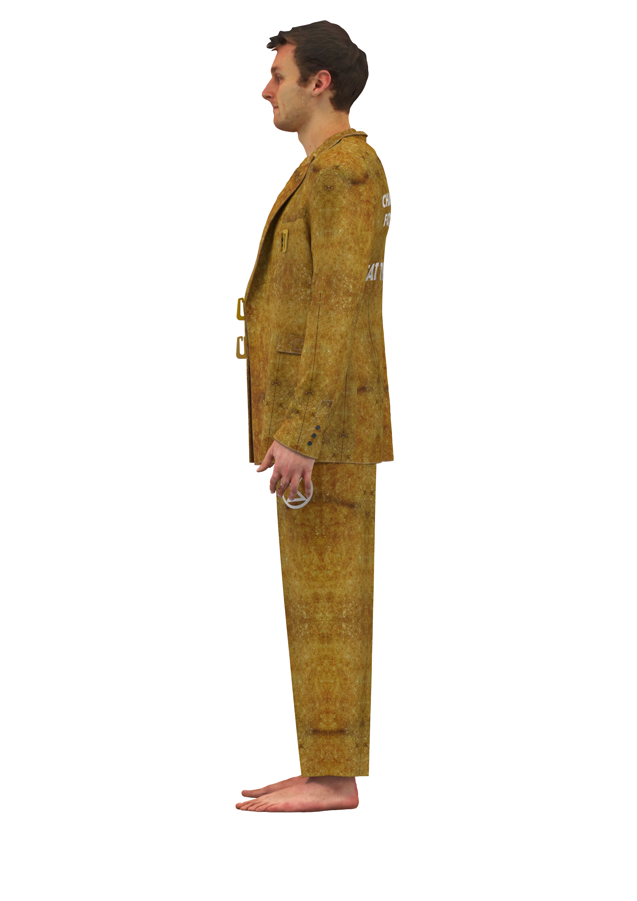
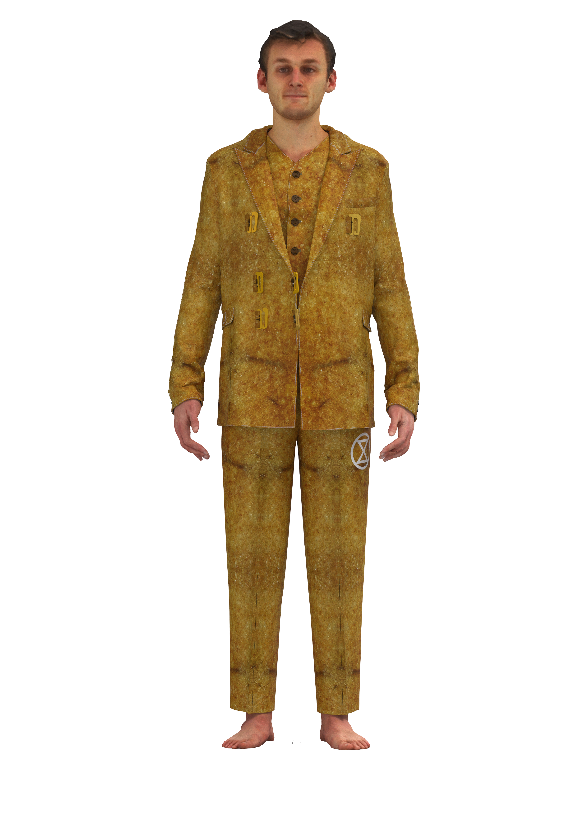

Intertwined activities
Protesting
Generating Design ideas
De waag projects
Internship
Laura Weller
AMFI 2023-2024

Slide 15

future
A phygital open-source biodegradable collection that can be worn during and supports an Extinction Rebellion blockade
planning
Aug | Sept | Oct | Nov | Dec | Jan | Feb | Maart | April | Mei | Juni
Finished research paper | Finished Rebel Interviews | Finished little samples | Finished fabric recipes | Finished molds | Finished 3D samples of finishings | Finished big materials in molds | Finished design ideas (6 looks) | Finished toiles | Finished all digital designs | Finished physical look(s)
Finished website understanding for documentation | Finished research on civil disobedience | Finished understanding De Waag and machines |  | Finished color research | Finished archetypical garment study | Finished digitalising materials |  | Finished finishings for garments 3D printed | Finished line up + finished renders | Finished photoshoot and other deliverables
Internship
Laura Weller
AMFI 2023-2024

Slide 16
Questions?
Internship
Laura Weller
AMFI 2023-2024

